Slide 1

Market Basket Analysis

Slide 2
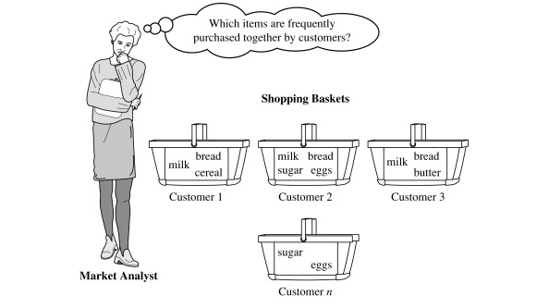
1) WHAT IS MARKET BASKET ANALYSIS? The most accurate Market Analysis definition is – a data mining technique that is used to uncover purchase patterns in any retail setting. The goal of Market Basket Analysis is to understand consumer behavior by identifying relationships between the items that people buy. For example: people who buy green tea are also likely to buy honey. So Market Basket Analysis would quantitatively establish that there is a relationship between Green Tea and Honey.

Slide 3
How does market basket analysis work? Market Basket Analysis is modelled on Association rule mining, i.e., the IF {}, THEN {} construct. For example, IF a customer buys bread, THEN he is likely to buy butter as well. Association rules are usually represented as: {Bread} -> {Butter} Some terminologies to familiarise yourself with Market Basket Analysis are: Antecedent: Items or ‘itemsets’ found within the data are antecedents. In simpler words, it’s the IF component, written on the left-hand side. In the above example, bread is the antecedent. Consequent: A consequent is an item or set of items found in combination with the antecedent. It’s the THEN component, written on the right-hand side. In the above example, butter is the consequent.

Slide 4
Types of Market Basket Analysis:
Descriptive market basket analysis: This type only derives insights from past data and is the most frequently used approach. The analysis here does not make any predictions but rates the association between products using statistical techniques. For those familiar with the basics of Data Analysis, this type of modelling is known as unsupervised learning.
Predictive market basket analysis: This type uses supervised learning models like classification and regression. It essentially aims to mimic the market to analyze what causes what to happen. Essentially, it considers items purchased in a sequence to determine cross-selling. For example, buying an extended warranty is more likely to follow the purchase of an iPhone. While it isn't as widely used as a descriptive MBA, it is still a very valuable tool for marketers.
Differential market basket analysis: This type of analysis is beneficial for competitor analysis. It compares purchase history between stores, between seasons, between two time periods, between different days of the week, etc., to find interesting patterns in consumer behaviour. For example, it can help determine why some users prefer to purchase the same product at the same price on Amazon vs Flipkart. The answer can be that the Amazon reseller has more warehouses and can deliver faster, or maybe something more profound like user experience.

Slide 5
Algorithms used in Market Basket Analysis:
There are Multiple Techniques and Algorithms are used in Market Basket Analysis. One of the important objectives is “to predict the probability of items that are being bought together by customers”.
AIS
SETM Algorithm
Apriori Algorithm
FP Growth
Apriori Algorithm:
Apriori Algorithm is a widely-used and well-known Association Rule algorithm and is a popular algorithm used in market basket analysis. It is also considered accurate and overtop AIS and SETM algorithms. It helps to find frequent itemsets in transactions and identifies association rules between these items. The limitation of the Apriori Algorithm is frequent itemset generation. It needs to scan the database many times which leads to increased time and reduce performance as it is a computationally costly step because of a huge database. It uses the concept of Confidence, Support.

Slide 6
With the help of the Apriori Algorithm, we can further classify and simplify the item sets that the consumer frequently buys. There are three components in APRIORI ALGORITHM:
Assume there are 100 customers
10 of them bought milk, 8 bought butter and 6 bought both of them.
bought milk => bought butter
support = P(Milk & Butter) = 6/100 = 0.06
confidence = support/P(Butter) = 0.06/0.08 = 0.75
lift = confidence/P(Milk) = 0.75/0.10 = 7.5

Slide 7
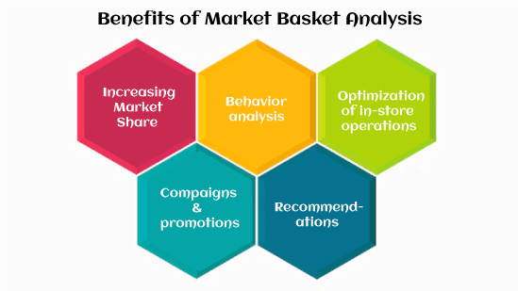
Benefits of Market Basket Analysis:
The market basket analysis data mining technique has the following benefits, such as:

